Slide 1

ASUCR Organization funding
2021-2022

Slide 2
Account Activation
All Registered Student Orgs that plan on applying for general funding and/or grants must activate their account.
Org accounts must be activated each Academic year.
Accounts can be activated anytime after September 7th and will expire early June.
Student Orgs will not be able to apply for funding unless the account has been activated.
Access to rollover/income funds will not be available until the account has been activated.

Slide 3
It’s a
3 Part Process
Apply for ASUCR Funding

Slide 4
Step 1: Activate THe Account
How to Activate the Account
View this Account Activation PowerPoint in its entirety
Take the Authorized Signers Test- be sure to enter your first and last name when you login
You may take the test as many times as needed to pass with an 80% or higher.
**NOTE: Score of the test will be verified by ASUCR. No need to print/turn-in a physical copy of your test**
Must fill out Authorized Signers Form

Slide 5
Authorized signers form
Must have at least 2 authorized signers, max of 3
Each authorized signers must take the Authorized Signers Test and needed prior to signing up for a finance hearing
Authorized signers are in charge of signing requisitions for org’s reimbursement. Without authorized signatures, reimbursements of any kind will not be approved.

Slide 6
STEP 2: PREPARING YOUR BUDGET
Prepare your budget according to the Orgs specifications
If you need assistance with your budget, schedule an appointment with the Organization Funding Specialist/ VP of Finance at (951)-827-3621
Please view slide 7 for an example budget

Slide 7
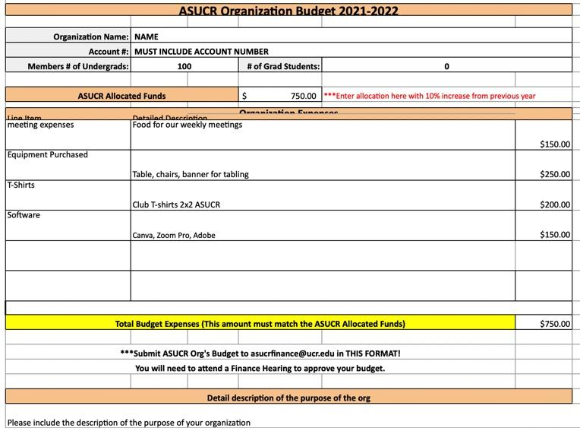
What to include on your budget
Please make sure to include the correct academic school year on your template.
Include the correct number of undergraduate students. Must have at least 10 registered on Highlander Link
# of Undergrad Students must exceed grad students by 80%.
Include all the line item/categories you are purchasing (line items not stated on the budget will not be reimbursed.. On description PLEASE state what specific items that will be purchased.
Check for the correct allocate amount for this academic year (Check through your previous ASUCR budget records to have the correct 10% allocation.
**Reminder: Please make budget shareable/ editable prior to budget submission. **

Slide 8
Step 3: Apply for Funding
All Orgs must be registered with Student Life in order to qualify for any ASUCR funding
Sign up through Google Forms to schedule a finance hearing (Beginning Fall Quarter). This can be found at asucr.ucr.edu in the Finance Tab.
Finance hearing will be given on a first come first serve basis
IMPORTANT NOTE: All submitted budget MUST be shareable and editable***

Slide 9
GENERAL FUNDING
ASUCR funding operates on a academic year (July 1st - June 30th)
Organization MUST have open membership to request for funding
Allocation begins at $750 for the first year
Allocation increases by 10% every year after available upon request (this means submitting a budget and signing up for a finance hearing)
Maximum allocation goes up to $3,500

Slide 10
Grant Allocation
Funding for ONE event per year
Event must be ON CAMPUS and open to ALL students to attend
Maximum allocation is $1,500
Please refer to the Funds charts for limitations and restrictions

Slide 11
ITEMS FUNDED by ASUCR
Meeting Expenses (Food for meetings)
Cultural Shows
Limited to $10/ member per meeting
Sign-in sheets of meeting attendees must be submitted along with requisition
NO GROCERY RECEIPTS WILL BE REIMBURSED
Make sure Highlander Link roster is updated
Cultural shows and event maximum funding: $1,500 from allocated funds. However, if you allocation is $750 that’s the maximum allowed for each event
Must be on campus events
NO workshops, entertainment, festivals, theme parks or ticketed admissions of any kind will be reimbursed. (This does not include registration fees)

Slide 12
ITEMS FUNDED by ASUCR (cont.)
Conferences, Tournaments, and Competitions are limited up to $1,500 from allocated funds. Please include who (names and SID #’s), what, where, when and a flyer detailing the event.
Banquets must be within a 40 mile radius. If your banquet is on campus, an approved caterer must be used.
If your Org has remaining income/rollover it may be used for Retreats, gifts, and non-related org activities, such as socials.
NO ALCOHOL WILL BE REIMBURSED UNDER ANY CIRCUMSTANCES.
  Receipts will be entirely disregarded if alcohol is listed
Expenses must be org related and for operating purposes

Slide 13
T-SHIRTS FUNDED BY ASUCR
Funding for t-shirt/uniforms out of allocated funds require a few steps:
T-shirt must be listed your org’s approved budget
Must include a 2x2 ASUCR logo anywhere on the shirt (ASUCR logo available on ASUCR website)
Preferably include the words “sponsored by”
Will need to attach a Print Preview from the VENDOR showing the design and location of the ASUCR logo along with a requisition
An additional t-shirt is needed to be purchased to be displayed in the ASUCR Bear’s Den. (Please deliver this to the ASUCR Front Office with requisition or upon receipt of the T-Shirts )
Allocated funds will pay up to 10% over the amount of members listed on the Highlander Link roster in Fall and over 5% over in Winter quarter
Limit of $15 per shirt (anything over will not be reimbursed)
**NOTE: T-shirts purchased during the Spring quarter will NOT be covered by allocated funds**

Slide 14
Speakers/ ProfessionAL Services
For payment of professional services/performer you MUST make an appointment with Org Funding Specialist first.
Must be a professional; can not pay a student, faculty, or staff.
Professional must provide federal tax ID number.
Payment is limited to $600 per year and MUST be a direct payment to the professional/performer. Reimbursement will not be processed.
These expenses must be relevant to the org’s mission statement and requested at least 2 weeks in advance. Failure to do so may result in no payment. No exceptions.
Payments will be made through Zelle

Slide 15
Allocated FUnd vs. Rollover Funds
Allocated funds are the funds that your org requests from ASUCR.
Allocated funds do not rollover and those funds may not be withdrawn (unspent funds will return to ASUCR by June 30th).
Any known rollover funds that is not acquired by the org before the end of Fall 2021 will not be rollover for the next year

Slide 16
Types of Request
Reimbursement- This can be requested when an org member has paid an org expense and needs to be reimbursed.
Purchase Order- From approved caterers/vendors are pre approval of funds not to exceed the amount stated on the Purchase Order (avoids paying for things out of pocket). Must be submitted 3 business days in advance from the date needed.
On-Campus Department- working with on campus department and need to pay for services for
Ex: HUB Event Scheduling to pay for room set-up and equipment or Subway for a sandwich platter for a meeting.
Direct Payment- paying a vendor directly for example: paying for registration for a conference or a speaker.
Payment request of any kind must start by filling out a requisition form

Slide 17

Requisition
  A requisition is a payment request, ASUCR can not process anything without it.
  The requisition form can be found at the ASUCR office and is also available on the ASUCR website www.asucr.ucr.edu under forms.
  ALL reimbursement payment will be made through ZELLE

Slide 18
HOw to fill out a requisition
Fill out every single field on the requisition
Especially the following ones:
  Name of Requestor (person requesting the funds).
  Cell/Phone # (number of the person who purchased the items).
  Payee (person getting reimbursed or vendor).
  Signature of an authorized signer (the authorized signer can not be the same as the person being reimbursed).
  Grand total (of the reimbursement).
  Attach itemized receipts/invoices.

Slide 19
Reimbursement
Please allow 10 business days for processing zelle transfers.
To avoid delay, attach all back up documentation to requisition.
Itemized receipts are required.
Reimbursements must be made to the person who paid for the item(s) directly.
Receipts cannot be dated more than 1 MONTH old and from a legitimate company. Proof of payment shall be clearly cited on the receipts.

Slide 20
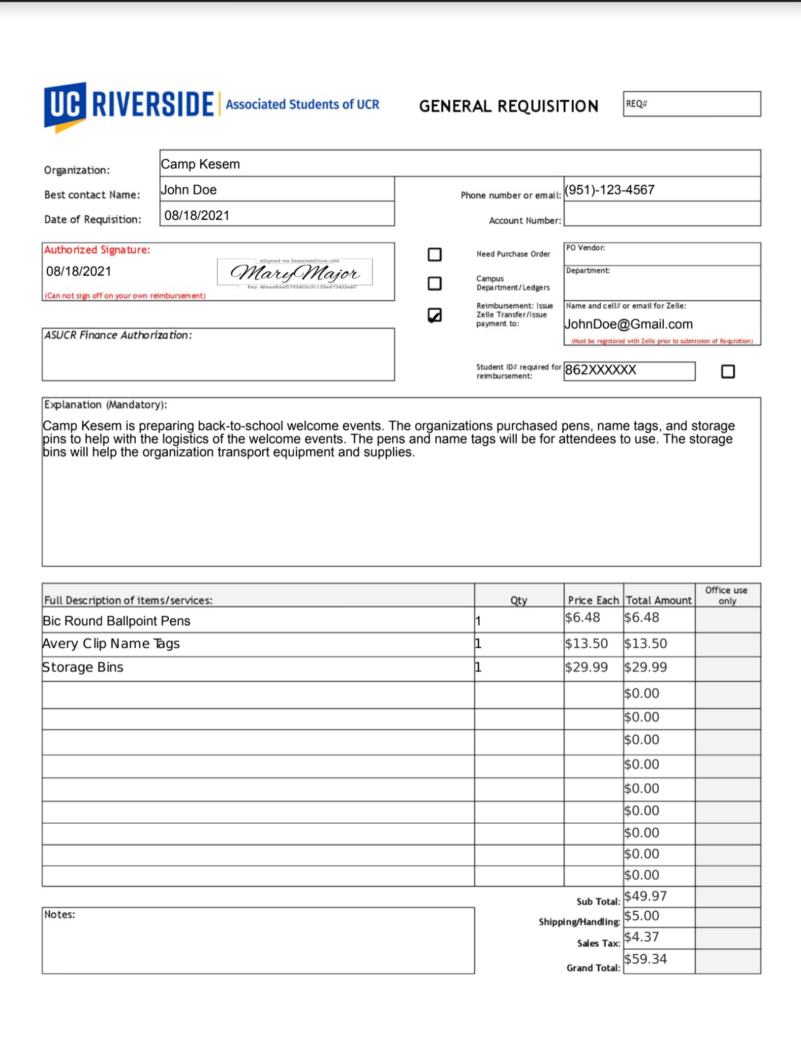
How a requisition for reimbursement should look like:
Name of the person who made the purchase or the person getting reimbursed
Include the phone number and email address of the person who did the purchase
MUST include the authorized signer’s signature. If it was the authorized signer who made the purchases, please have another authorized signer complete the signature. Note: Authorized signer must be the one of the signer that is registered with ASUCR
The student ID of the individual who is getting reimbursed
Include explanation of the purchases made and on the line items below, please list out each and every item that was purchased

Slide 21
ON Campus Departments
On-Campus Department services are paid via a recharge. This is done with the use of an account number also known as the FAU.
Some examples:
  If the org wants to order a sandwich platter from Subway or any of the other Dining venues.
  Check out a room with media from HUB Event Scheduling.
  Renting the Theatre for a cultural event.
  Printing and Reprographics.
Planning ahead of time will alleviate you from having to pay out of pocket. ASUCR needs at least 3 business days to process.

Slide 22
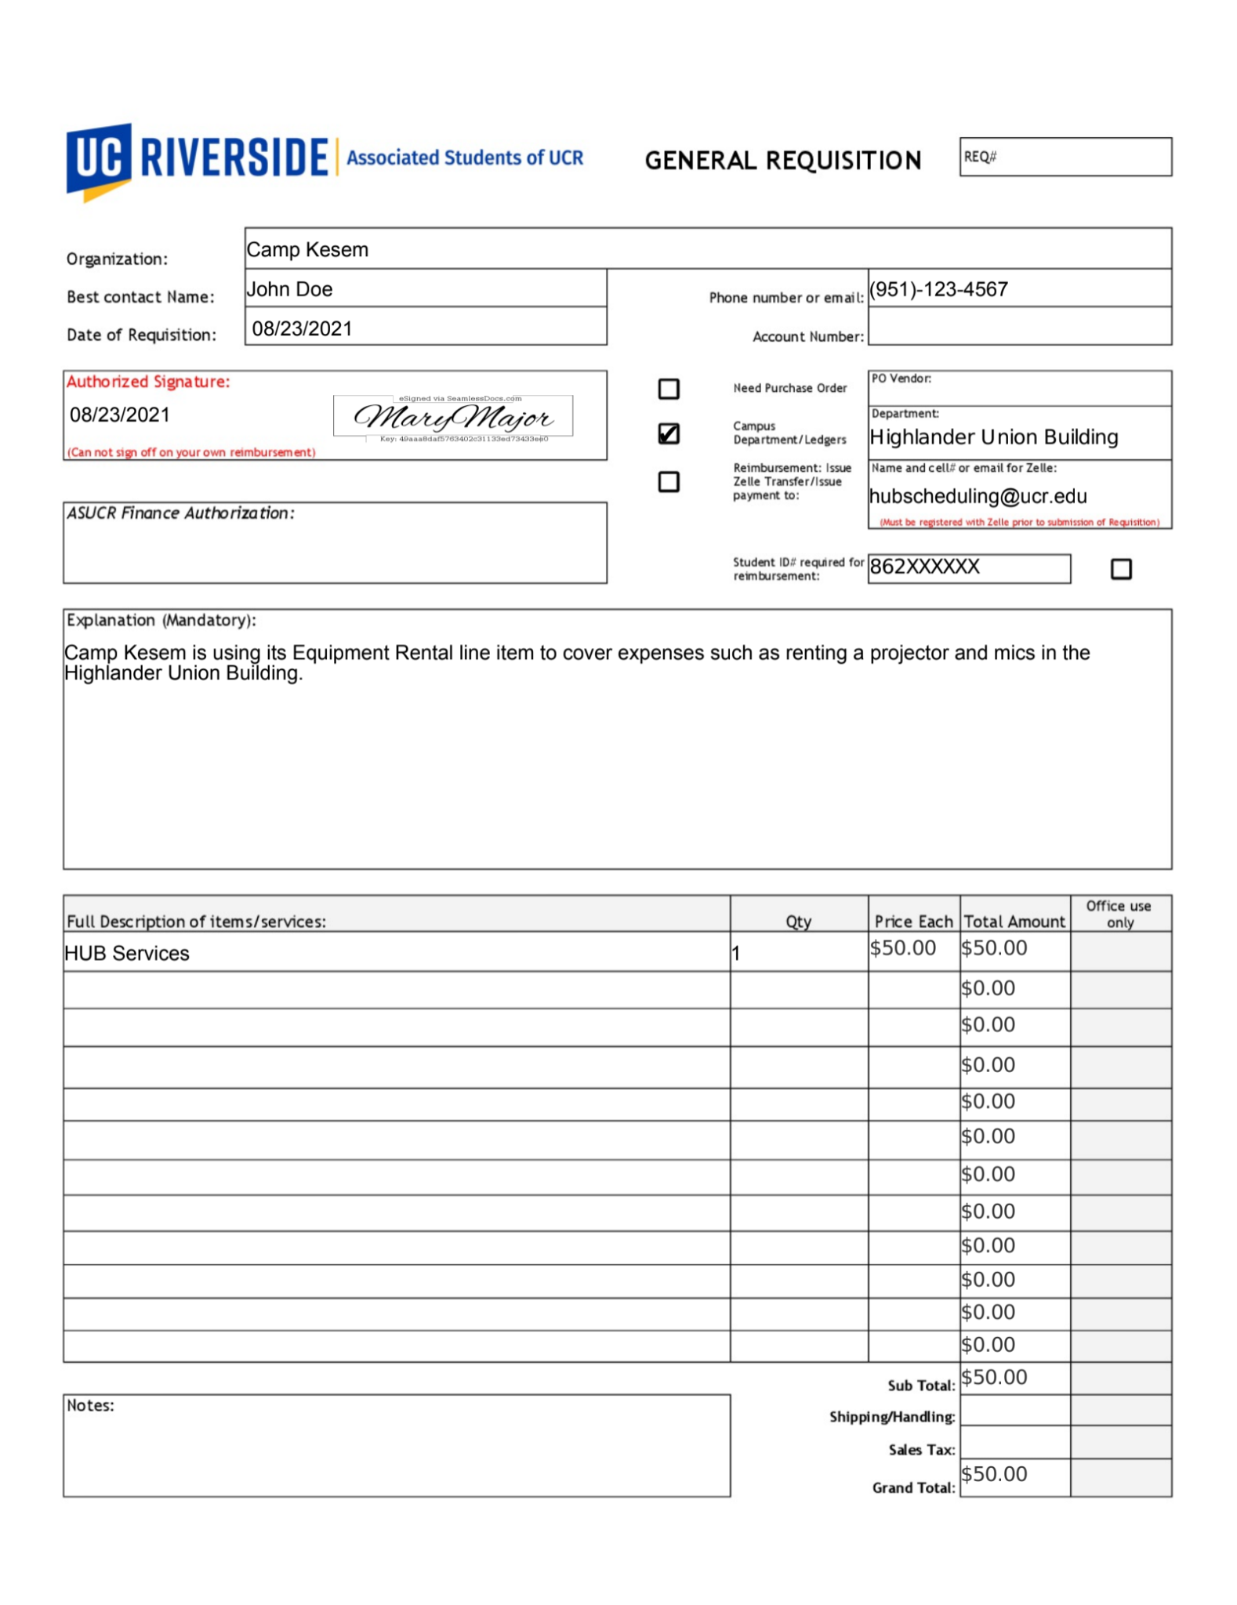
HOw Requisition for Campus Departments should look like
Include the phone number and email address of the requestor
Name of the requester
Please include the department of where you are seeking the services from
MUST include the authorized signer’s signature. Note: Authorized signer must be the one of the signer that is registered with ASUCR
Include explanation of the services needed and on the line items below, please list out each and every item needed

Slide 23
Purchase Order
Must be submitted at least 3 business days in advance.
It avoids paying out of pocket.
Process:
  Fill out a requisition.
  Attach invoice/quote
  3 business days later you pick up the PO from the ASUCR office and take it to the vendor.
  Return the receipt to the ASUCR office.
Privileges may be revoked if receipts are not received within 1 week.

Slide 24
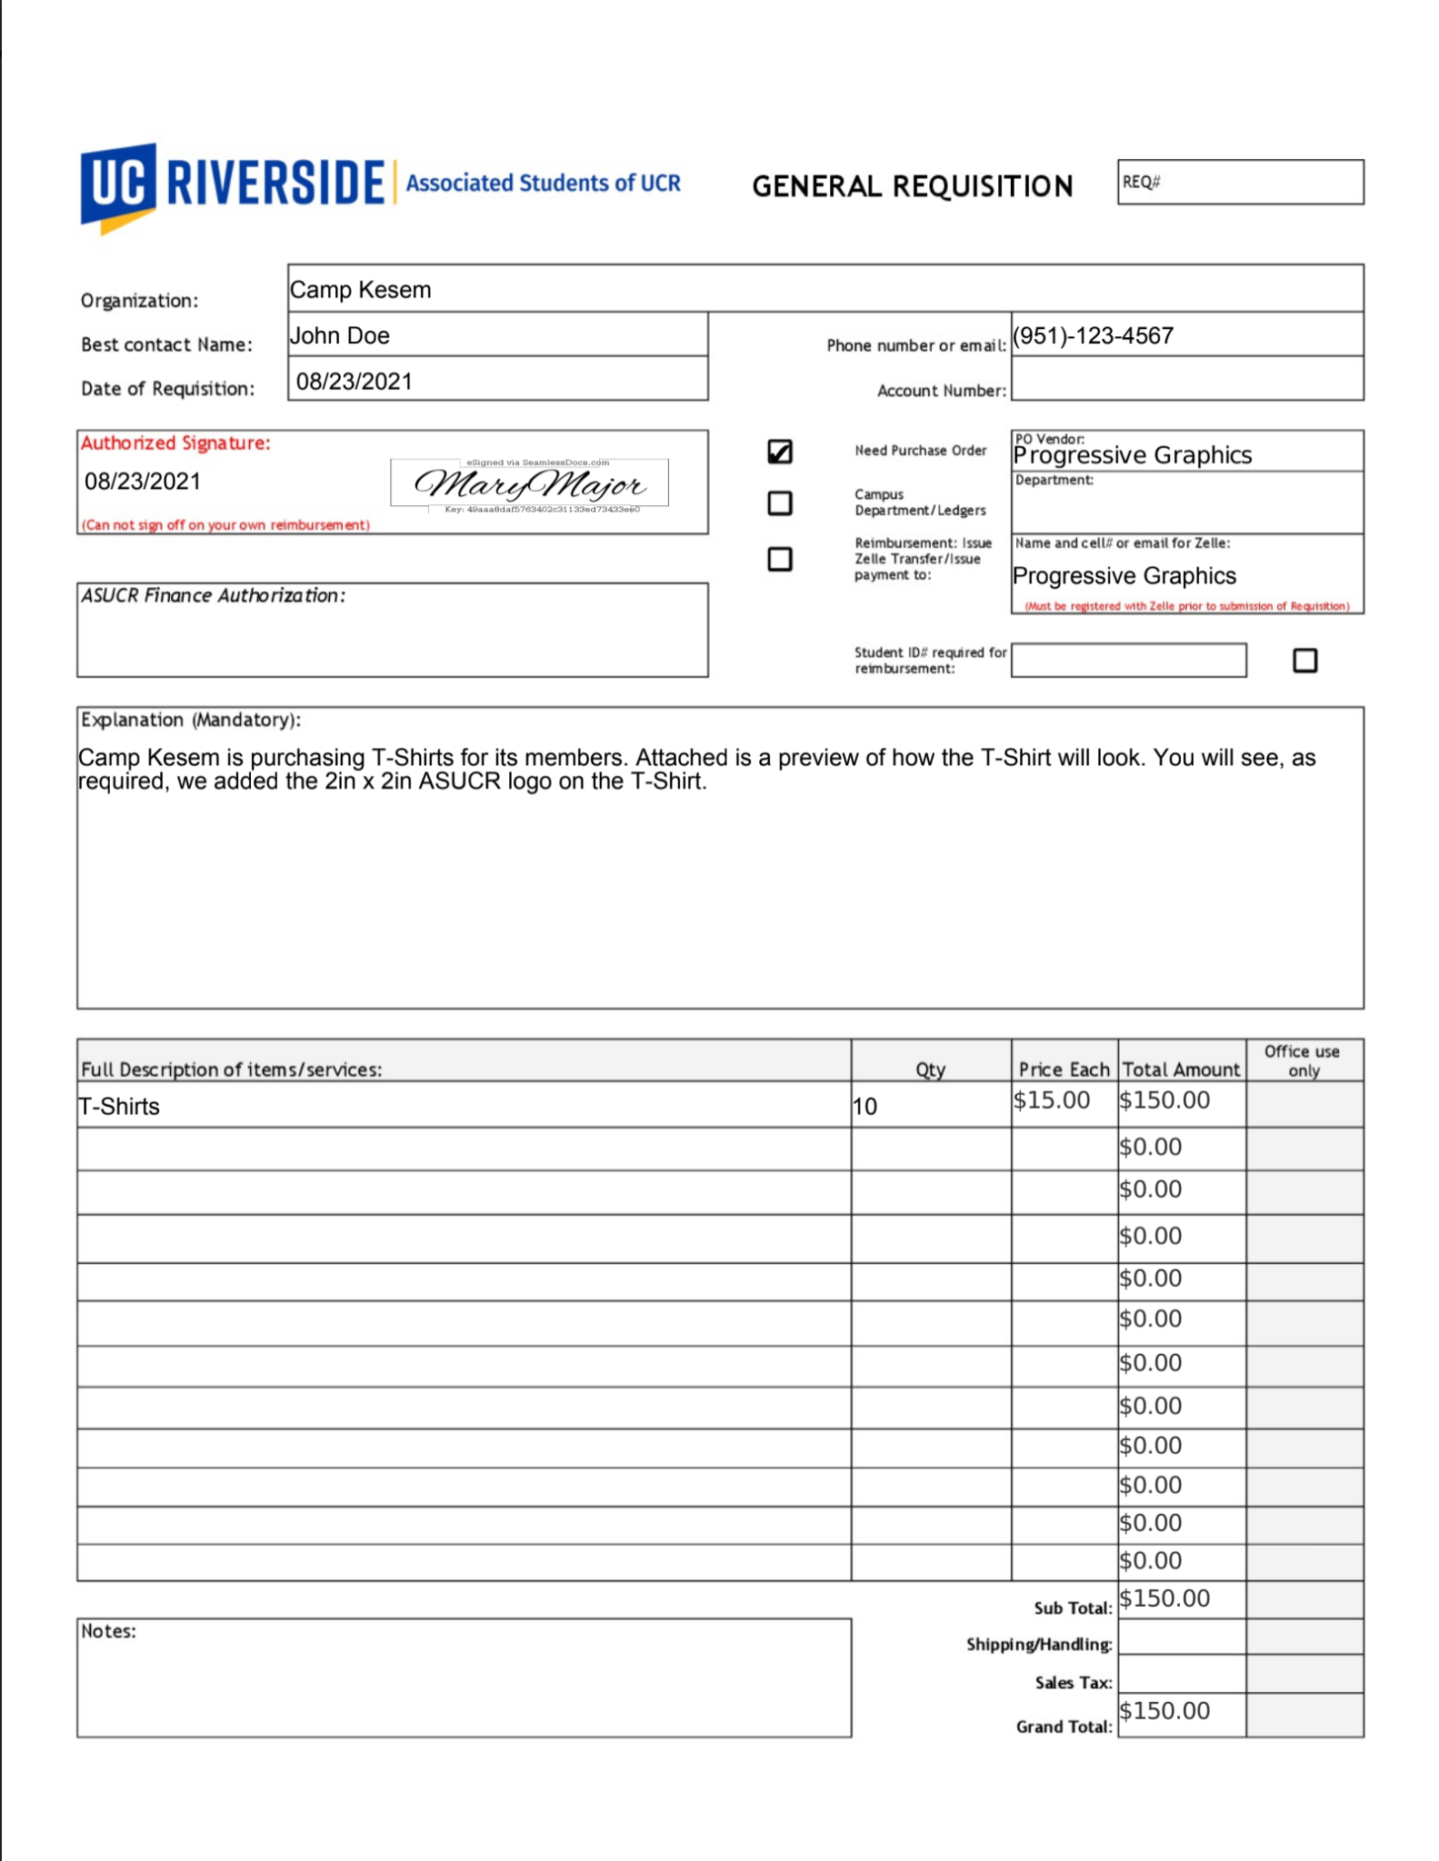
How requisition for PO Requests should look like:
Name of the person requesting the PO
Include the phone number and email address of the requestor
MUST include the authorized signer’s signature. Note: Authorized signer must be the one of the signer that is registered with ASUCR
Please state the vendor you are purchasing from
Include explanation of the services and on the line items below, please list out each and every item

Slide 25
Direct payment
If ASUCR is paying a vendor directly on the org’s behalf you must provide a copy of their W-9 and an invoice.
May take up to 2 weeks to process payment via zelle if the vendor is not setup with Zelle.
An example would be paying for a Professional Service such as a Speaker, DJ, etc. This must be handled as a direct payment. No reimbursement will be allowed.

Slide 26
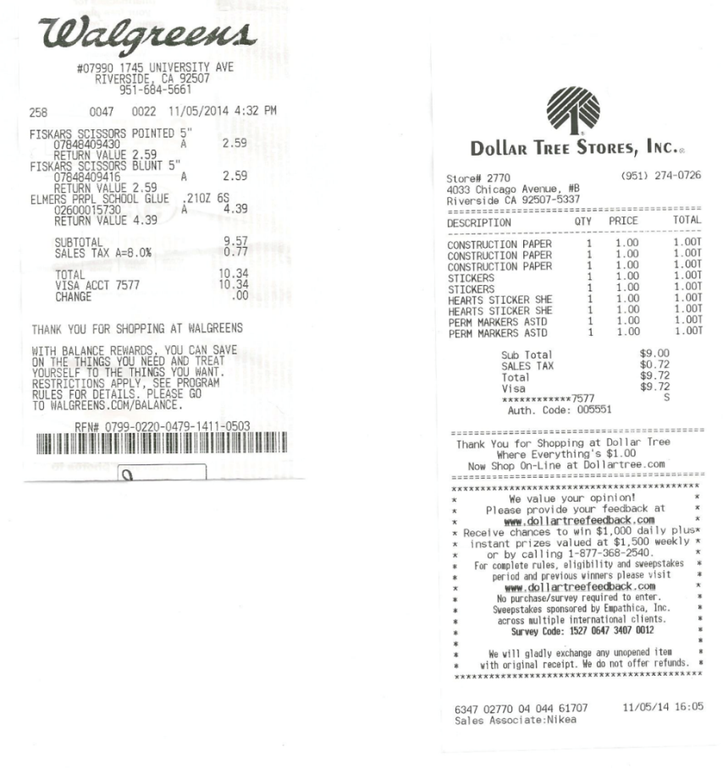
How you receipt should look like
Only itemized receipts are accepted.
Any personal items should NOT be listed on the receipts.
Do not write on the receipts as they may not be reimbursable.

Slide 27
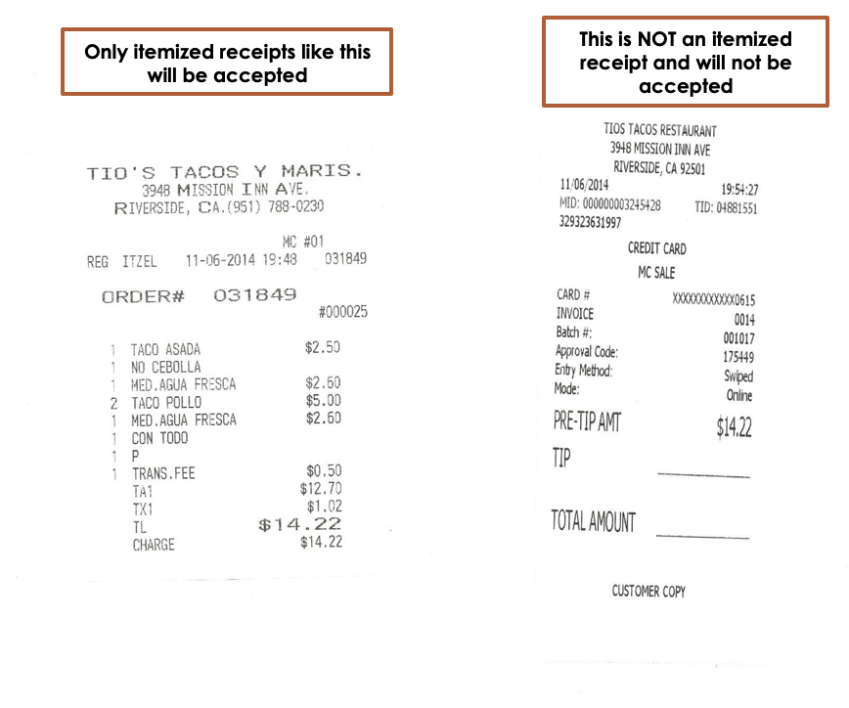
HOW YOUR RECEIPTS SHOULD LOOK

Slide 28
At least one Authorized Signer of your org must attend a finance hearing in order to receive funding.
Sign-ups for Finance Hearing will be accessible through our ASUCR website (asucr.ucr.edu). It is on a first come first served basis, so signing up early is highly encouraged. You must sign up no later than 3 days prior the finance hearing
You must submit your budget BEFORE signing up for a hearing.
Finance Hearing will be potentially held through Zoom
Links to Zoom meetings will be forwarded to you prior to hearings.
FINANCE HEARING

Slide 29

NEED ASSISTANCE?
If you have any questions regarding creating your budget, please call the front desk at 951-827-3621 and schedule an appointment with Organization Funding Specialist.
Meeting with the Organization Funding Specialist is highly encouraged before submitting your budget.
Please refer to this PowerPoint and the ASUCR website throughout the year if you need a refresher on the funding procedures.
Email us: asucrfinance@ucr.edu

