Slide 1
Account Activation for Organizations
2018-2019

Slide 2
Account Activation
All Registered Student Orgs that plan on applying for general funding and/or grants must activate their account.
Org accounts must be activated each Academic year.
Accounts can be activated anytime after August 1st and will expire early June.
Student Orgs will not be able to apply for funding unless the account has been activated.
Access to rollover/income funds will not be available until the account has been activated.

Slide 3
It’s a three part process
Step 1: Activate the account
How to activate the account
View this Account Activation PowerPoint in its entirety.
Take the Authorized Signers Test - be sure to enter your first and last name when you log in.
YOU DO NOT NEED TO PRINT/TURN IN A COPY OF YOUR TEST - Your test score will be verified by ASUCR.
You may take the test as many times as needed to pass with an 80% or higher.

Slide 4
Requirements
Must pass the test with a minimum of 80%
A minimum of 2 and a maximum of 3 members must complete the test (Members usually consist of the President, the VP, and/or the Treasurer. All signers must be current full-time undergraduate students, which means must be enrolled in at least 12 units and cannot be wait-listed for any classes below the 12 units. These individuals are known as the Authorized Signers.)
Once the requirements are met, complete the Authorized Signers Form and return the original copy to the ASUCR office at the front desk. Wet signatures are required (hand written and in ink).
Authorized signers are the only members who can sign on behalf of the org.
Every requisition must be signed by one of the authorized signers. Only one signature is required. Authorized signer CAN NOT sign for their own reimbursements.

Slide 5
Step 2: Preparing your budget
Prepare your budget according to your Orgs specifications.
If you need assistance with your budget, schedule an appointment with the Organization Funding Specialist at (951) 827-3621. Any questions or concerns can be addressed at this time.
Step 3: Apply for funding
Email your budget to asucrfinance@ucr.edu
Sign up in-person or call the front desk at 951.827.3621 between 8 A.M. to 5 P.M. to schedule a finance hearing (Beginning Fall Quarter). Please note: In-person sign up will be given priority.
All Orgs must be registered with Student Life in order to qualify for any ASUCR funding.

Slide 6
General Organization Funding
ASUCR operates on a fiscal calendar (July 1st –June 30th)
Funding for the school year
Must have open membership
Allocations begins at $750, increases 10% every year after available upon request (by submitting a budget and signing up for a finance hearing)
Maximum of $3,500

Slide 7
Grant allocation
Funding for one event per year
Event must be ON CAMPUS and open to ALL students to attend
Maximum allocation is $1,500
Please refer to the Funds charts for limitations and restrictions

Slide 8
Items funded by Asucr
Meeting Expense (Food) has a limit of $10 per member per meeting. You must use a UCR approved caterer and submit an ASUCR funded meeting food form. The approved caterers and form can be found on the ASUCR Website under Org Funding; Meeting Requirements. No grocery receipts will be reimbursed. (Make sure Highlander Link roster is updated)
Culture shows and events will be limited up to $1,500 from allocated funds. However, if your allocation is $750 that’s the maximum allowed for such event. No workshops, entertainment, festivals, theme parks or ticketed admissions of any kind will be reimbursed (This does not include registration fees).

Slide 9
Conferences, Tournaments, and Competitions are limited up to $1,500 from allocated funds. Please include who (names and SID #’s), what, where, when and a flyer detailing the event.
Banquets must be within a 40 mile radius. If your banquet is on campus, an approved caterer must be used.
If your Org has remaining income/rollover it may be used for Retreats, gifts, and non-related org activities, such as socials.
NO ALCOHOL WILL BE REIMBURSED UNDER ANY CIRCUMSTANCES.
Receipts will be entirely disregarded if alcohol is listed
Expenses must be org related and for operating purposes

Slide 10
T-Shirts funded by ASUCR
Funding for t-shirts/uniforms out of allocated funds require a few steps:
Must be listed on your org's approved budget.
Must include the ASUCR logo. (minimum size 2x2) download the logos on the ASUCR website.
Preferably include the words "sponsored by".
Will need to attach a Print Preview from the VENDOR showing the design and location of the ASUCR logo along with a requisition.
Will need to purchase an additional t-shirt which will be displayed in the ASUCR Bear's Den. This needs to be delivered to the ASUCR Front office with the requisition or upon receipt of the t-shirts.
Allocated funds will pay up to 10% over the amount of members listed Highlander Link roster in Fall quarter and 5% over in Winter quarter. T-shirts ordered in Spring quarter will not be covered by allocated funds.

Slide 11
Speakers/Professional services
For payment of professional services/performer you MUST make an appointment with Org Funding Specialist first.
Must be a professional; can not pay a student, faculty, or staff. With a federal tax ID number.
Payment is limited to $600 per year and MUST be a direct payment to the professional/performer. Reimbursement will not be processed.
These expenses must be relevant to the org’s mission statement and requested at least 2 weeks in advance. Failure to do so may result in no payment. No exceptions.

Slide 12
Allocated funds vs Rollover
As of July 1, 2016 ASUCR will no longer require a 15% income requirement and will no longer accept deposits into org accounts. However, your org may have unused rollover/income from previous years.
You may request to withdrawn the funds from your ASUCR to be deposited in your Org’s outside bank account, however, an org outside bank account needs to be established.
Allocated funds are the funds that your org requests from ASUCR.
Allocated funds do not rollover and those funds may not be withdrawn (unspent funds will return to ASUCR by June 30th).

Slide 13
Type of request
Reimbursement- after the fact transaction when an org member has paid an org expense and needs to be reimbursed.
Purchase Order- From approved caters/vendors are preapproval of funds not to exceed the amount stated on the Purchase Order (avoids paying for things out of pocket). Must be submitted 3 business days in advance from the date needed.
On-Campus Department- working with on campus department and need to pay for services for example: HUB Event Scheduling to pay for room set-up and equipment or Subway for a sandwich platter for a meeting.
Direct Payment- paying a vendor directly for example: paying for registration for a conference or a speaker.

Slide 14
Reimbursement/Purchase order/ on-campus department/direct payment
Every transaction starts with a requisition (check/payment request).
After the fact (transaction) is a reimbursement. Usually takes about 2 weeks for check reimbursements.
Before the fact (transaction) is a Purchase Order/On-campus Department/Approved caterer, or Direct Payment. (Planning ahead of time can alleviate paying out of pocket) Please allow at least 3 business days to process.
If the transaction involves a reimbursement, only original receipts will be accepted and must be paid to the person who paid for the transaction. Reimbursements MUST include proof of payment. Only students or advisors can get reimburse.

Slide 15
Requisition
A requisition is a check/payment request, ASUCR can not process anything without a it.
The requisition form can be found at the ASUCR office and is also available on the ASUCR website www.asucr.ucr.edu under forms.
Online requisitions are not automatically numbered. ASUCR asks you to number them in the following format: last 3 digits of your account and 6 digit of the date.
If you have multiple requisitions in 1 day use A, B, C, etc. at the end.
Example: Your org account number is 12345 and the date was July 12, 2018 you’d use number 345071218A on the requisition.

Slide 16
How to fill out a requisition
Fill out every single field on the requisition
Especially the following ones:
Name of Requestor (person requesting the funds).
Cell/Phone # (number of the person who purchased the items).
Payee (person getting reimbursed or vendor).
Signature of an authorized signer (the authorized signer can not be the same as the person being reimbursed).
Grand total (of the reimbursement).
Attach original itemized receipts/invoices.

Slide 17
Reimbursement
Please allow two weeks for processing checks.
To avoid delay, attach all back up to requisition.
Original, itemized receipts are required. Duplicates and copies will not be accepted.
Please tape the corners of receipts to a separate sheet of paper so each is clearly visible behind the requisition.
Reimbursements must be payable to the person who paid for the item(s) directly.
Receipts cannot be dated more than 1 MONTH old and from a legitimate company. Proof of payment shall be clearly cited on the receipts.
All checks will be mailed out so be sure the address is correct.

Slide 18
How a requisition for reimbursements should look like:
Req # is last 3 numbers of account # and the date you made the requisition
Only one signature is required from one Authorized Signer. Please note that the Authorized Signer and the person getting reimbursed can not be the same person.
Of the person being reimbursed
✓
For internal use only
Make sure the address is correct because checks are mailed out.
What, where, when, who & why!
List your receipts by vendor and break them down by explanation use
For internal use only

Slide 19
On-campus departments
On-Campus Department services are paid via a recharge. This is done with the use of an account number also known as the FAU.
Some examples:
If the org wants to order a sandwich platter from Subway or any of the other Dining venues.
Check out a room with media from HUB Event Scheduling.
Renting the Theatre for a cultural event.
Printing and Reprographics.
Planning ahead of time will alleviate you from having to pay out of pocket. ASUCR needs at least 3 business days to process.

Slide 20
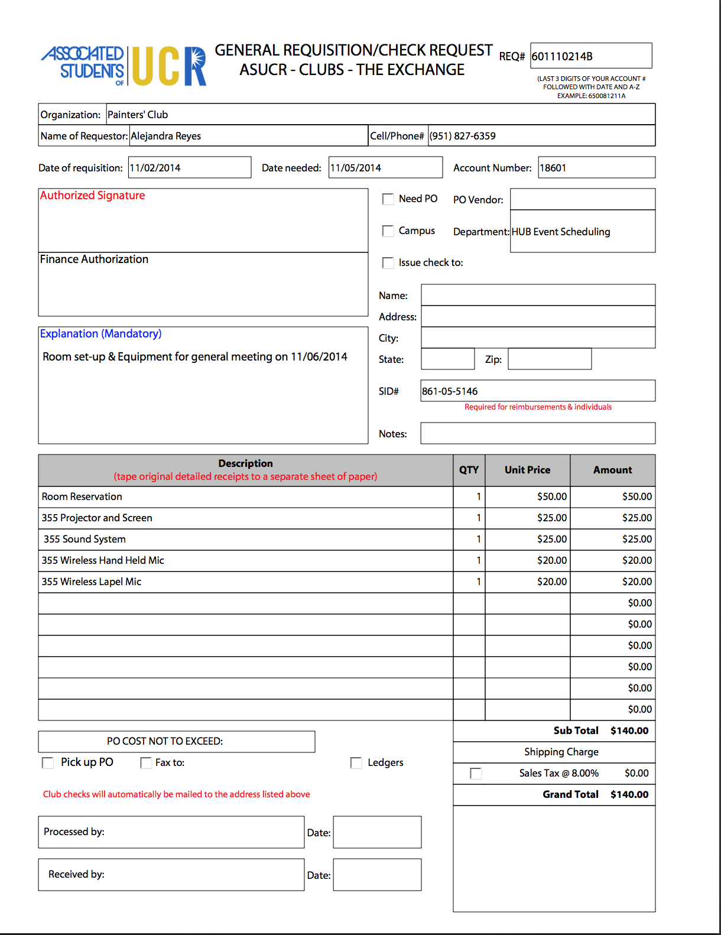
How requisition for Campus departments should look like:
Req # is last 3 numbers of account # and the date you made the requisition
Only one signature is needed from one Authorized Signer
✓
Signature of ASUCR’s VP of Finance ONLY
List all the items that will show up on your event summary/invoice
For internal use only

Slide 21
Purchase Order
Must be submitted at least 3 business days in advance.
It avoids paying out of pocket.
Process:
Fill out a requisition.
Attach invoice/price estimate.
3 business days later you pick up the PO from the ASUCR office and take it to the vendor.
Return the receipt to the ASUCR office.
Privileges may be revoked if receipts are not received within 1week.

Slide 22
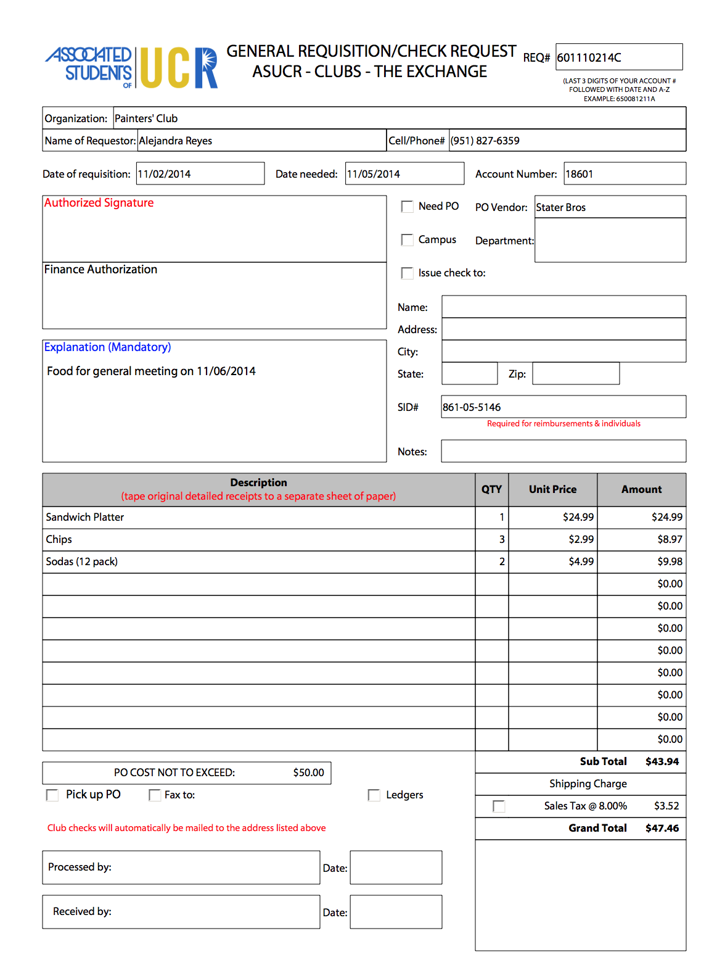
How requisition for PO Requests should look like:
REQ # is last 3 numbers of account # and the date you made the requisition
Only one signature is needed from one Authorized Signer
✓
Signature of ASUCR’s VP of Finance ONLY
List all the items that will show up on your receipt
Be sure not to exceed the amount on PO
✓
For internal use only

Slide 23
Direct payment
If ASUCR is paying a vendor directly on the org’s behalf you must provide a copy of their W-9 and an invoice.
May take up to 2 weeks to process the check.
An example for processing direct payment would be paying for registration for a conference.
Another example would be paying for a Professional Service such as a Speaker, DJ, etc. This must be handled as a direct payment. No reimbursement will be allowed.

Slide 24
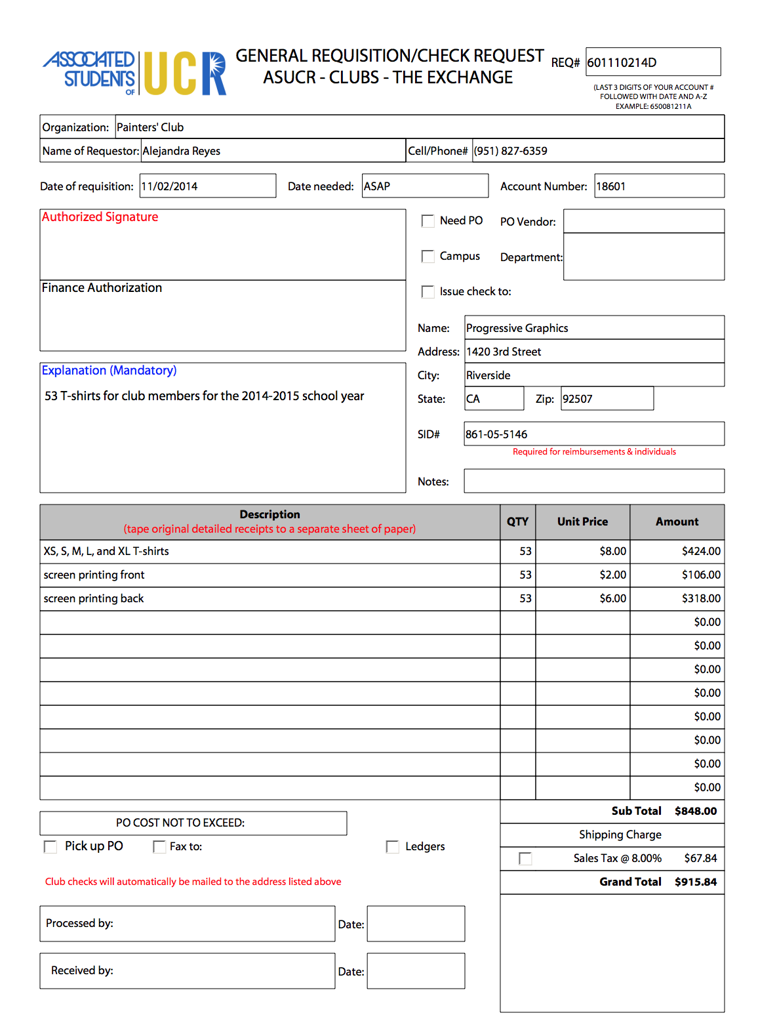
How requisition for direct payments should look like:
Req # is last 3 numbers of account # and the date you made the requisition
Only one signature is required from one Authorized Signer
✓
✓
For internal use only
Make sure the address is correct because checks are mailed out.
For internal use only

Slide 25
How your receipts should look
Only ORIGINAL receipts will be accepted.
Any personal items should NOT be listed on the receipts.
Tape only the corners of each receipts as the ink will fade.
Do not write on the receipts as they may not be reimbursable.

Slide 26
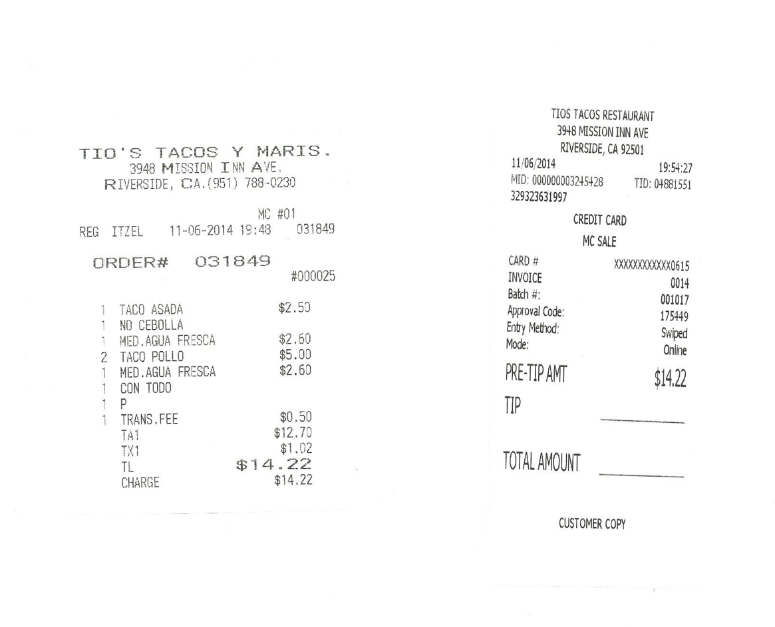
How your receipts should look
Only itemized receipts like this will be accepted
This is NOT an itemized receipt and will not be accepted

Slide 27
Finance Hearings
At least one member of your org must attend a finance hearing in order to receive funding.
The sign-up sheet comes out 1 ½ week prior and you must sign up no later than 3 days prior the finance hearing. It is on a first come first served basis, so signing up early is highly encouraged.
You must submit your budget BEFORE signing up for a hearing.

Slide 28
need additional assistance???
If you have any questions regarding creating your budget, please call the front desk at 951-827-3621 and schedule an appointment with Organization Funding Specialist.
Meeting with the Organization Funding Specialist is highly encouraged before submitting your budget.
Please refer to this PowerPoint and the ASUCR website throughout the year if you need a refresher on the funding procedures.

