Slide 1
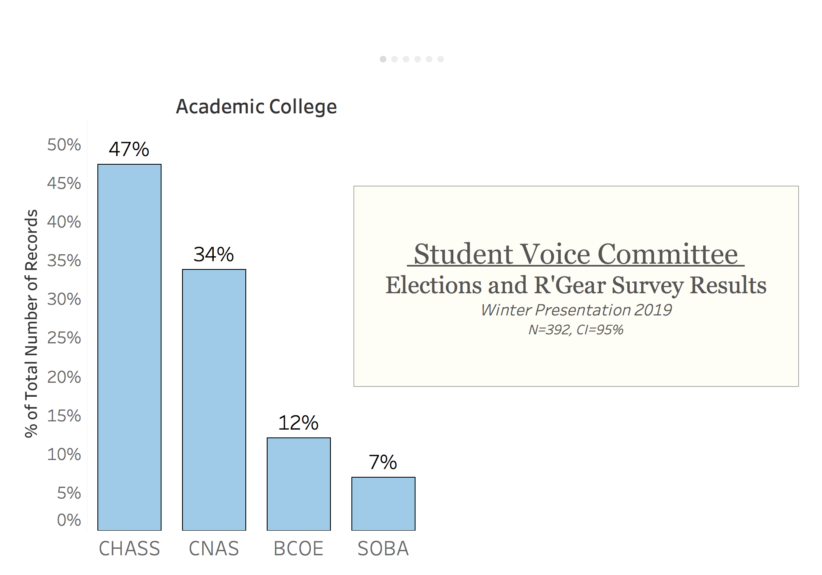
Notes:
Hello/Welcome. Last quarter SVC completed a survey on elections and a short survey on R’gear. Before we go over the results from those surveys, I’d like to quickly go over our sampling method. N=392, CI=95%, we survey a specific number of students from each academic college, etc.

Slide 2
ASUCR Elections Survey
Notes:
So we’ll start with the Elections Survey. The purpose of this survey was to identify pain points in the elections process and gain insights from students on how we can increase our voter turn-out rate from 14%.

Slide 3
Notes:
First, we asked students if they even knew that the required 20% voter-turn out rate for referendums was not met last year. 67.3% of students did not know, 17% said yes, 15% were freshmen so they were counted as N/A.

Slide 4
Notes:
Next, we wanted to find out if students were simply apathetic towards voting in campus elections. Contrary to prior thoughts, 84% of students believe that their vote makes a difference/impact on campus.

Slide 5
Notes:
Of the 16% that said no, most students cited not seeing any changes on campus and having a general lack of interest in voting. Other students cited reasons such as: *read all no responses*

Slide 6
Notes:
But students still overwhelmingly believe their vote makes a difference or impact on campus, which does not signal apathy in student voters. So why aren’t students voting?

Slide 7
Notes:
We gave students a long list of options and asked them to select the top three options that would make them want to vote and/or run in next year’s elections. Students said: More information on Elections Process, More Incentives, Voting Location Accessibility. Their 4th and 5th choices were having a more diverse rang of candidates and shorter voting lines.

Slide 8
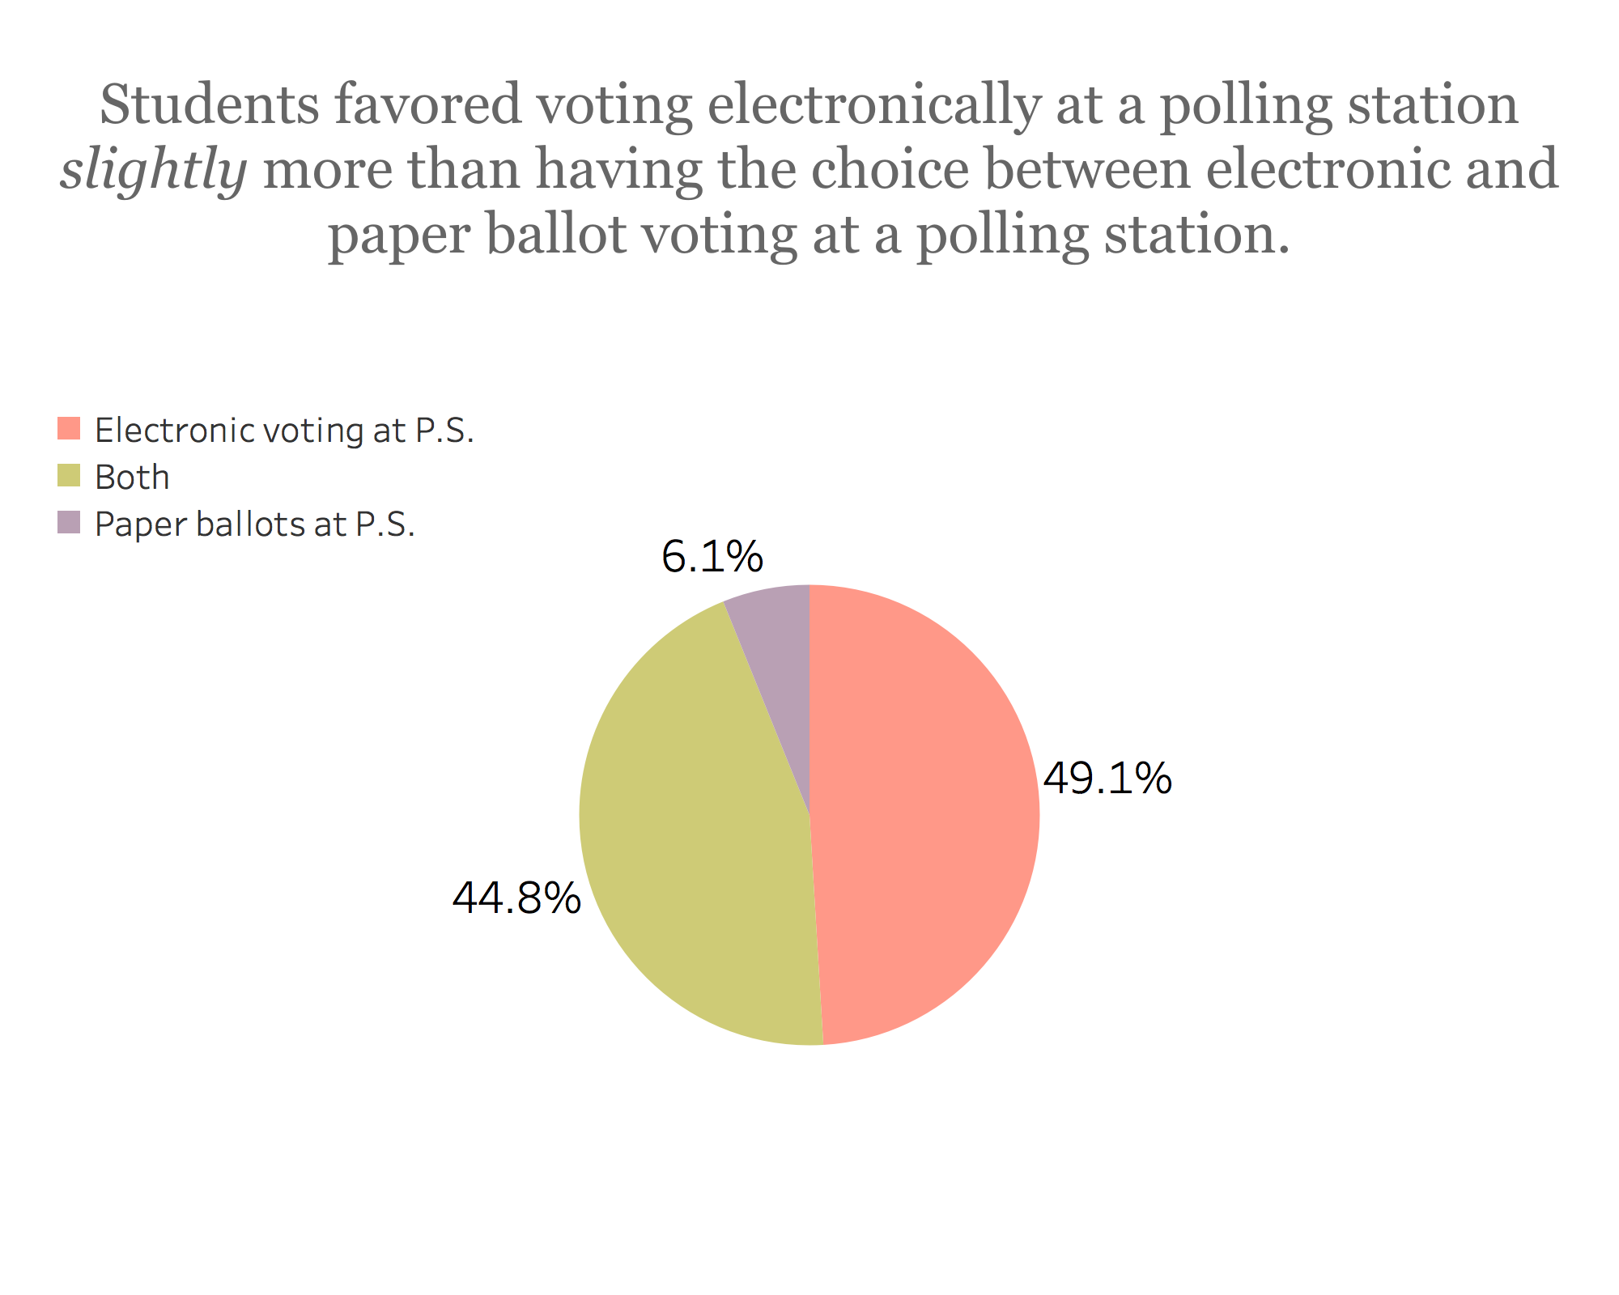
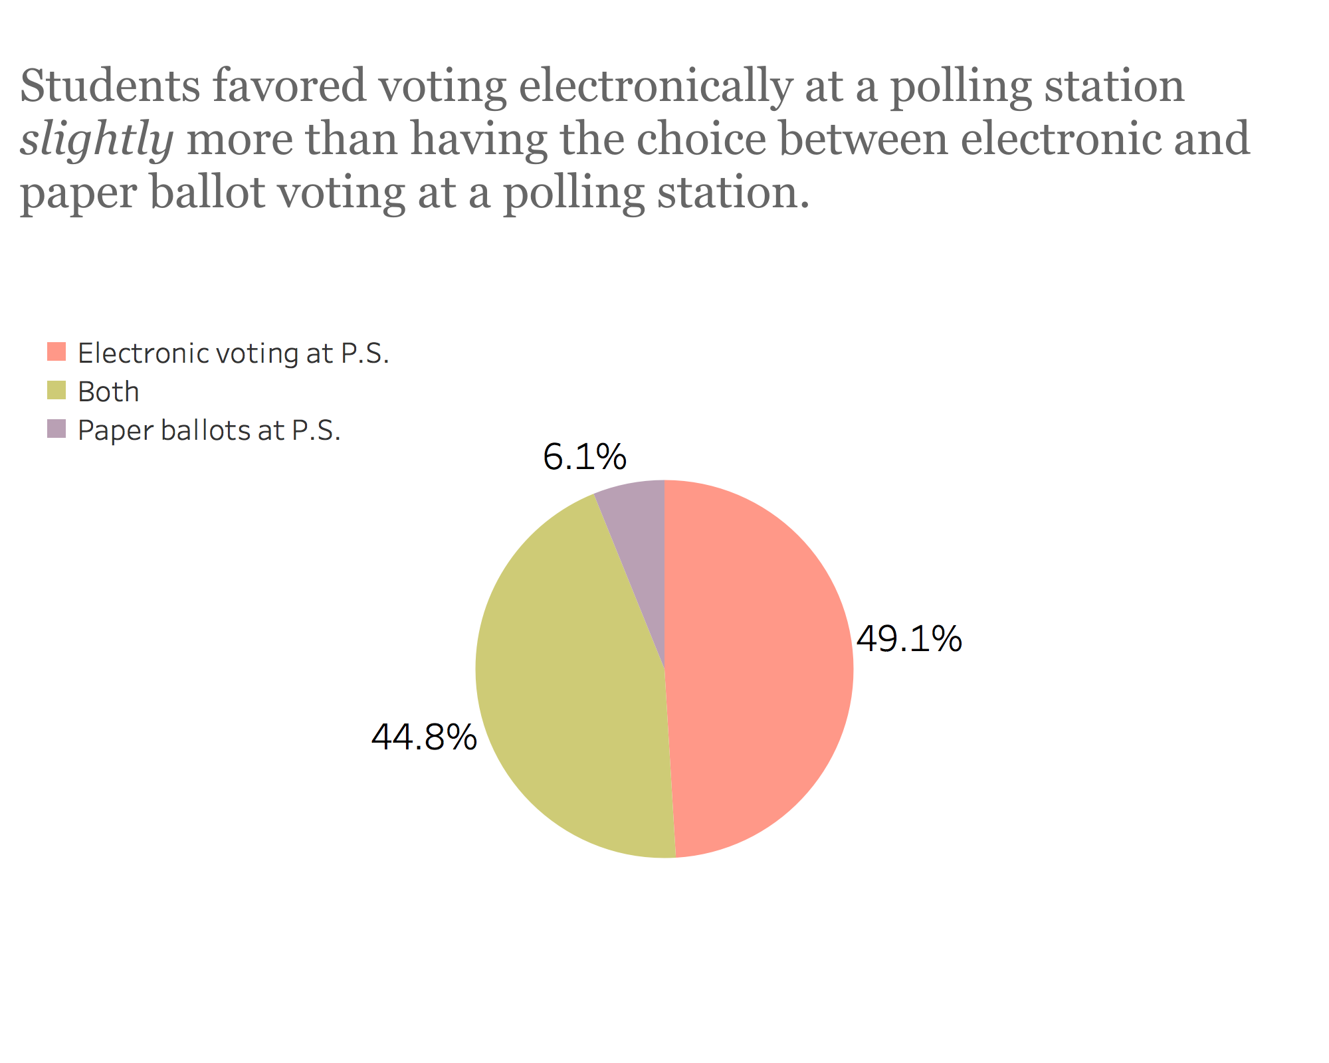
Notes:
We also wanted to identify how students would prefer to vote at polling stations. Paper ballots were inefficient for ASUCR, but were they inefficient for students as well? We found out that students would in fact greatly prefer Electronic voting @ PS over paper ballots

Slide 9
Recommendations
Improve distribution of information to students about elections
Provide more voting incentives to students
Improve voting location accessibility
Attract a more diverse range of candidates
Shorten voting lines (make the process of voting more efficient)
Use electronic voting at polling locations, use paper ballots as back-up
Improve visibility of ASUCR and it’s impact on campus for apathetic voters

Slide 10
ASUCR R’Gear Survey
Notes:
So moving onto the R’Gear Survey, we used the same sampling distribution as we did for the Elections Survey. And our goal with the R’Gear survey was to see if the majority of students were in support of the initiative.

Slide 11
Notes:
We wanted to see if students knew what R’Gear was. 71% said yes, they do know what R’Gear is.

Slide 12
Notes:
Then, we asked students if they supported R’Gear and wanted it to continue, the majority of students (86%) do want it to continue. However, that number sharply decreased when we asked students if they supported spending $35,000 on R’Gear. 51% of students said yes, they supported spending $35,000, while 48% of students said no.

Slide 13
Notes:
We asked those students who did not support spending 35K on R’Gear why, most cited reasons such as “too much $...” and “$ could be….” *Read all responses*

Slide 14
Notes:
Then we gave all students, regardless of if they support R’Gear or not, a list of options that they would most prefer ASUCR to invest the $35,000 in. The majority of students chose “Making Textbooks Cheaper” and “School Supplies” while others chose Campus Beautification and some still preferred R’Gear.

Slide 15
Notes:
Because R’Gear was released around the same time as elections last year, we asked students if they would prefer the option of picking up their R’Gear from a polling location. 81% of students said yes…etc.

Slide 16
Recommendations
Slightly more than half of the student body supports spending $35,000 on R’Gear, however, nearly half of the student body does not support spending $35,000 on R’Gear. This suggests ASUCR should try to accommodate both needs of students.
Keep R’Gear, but only distribute to freshmen to cut back on costs
Reduce amount of R’Gear produced and distribute in lowered amounts at select events to increase turn-out/school spirit throughout school year (sports games, ASUCR events, etc.)
Focus on encouraging senators to use contingency money for special projects (i.e. making textbooks cheaper, school supplies, campus beautification)

Slide 17
Thank you!

